Slide 1
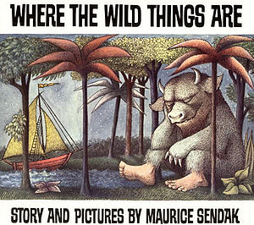
Old Wire Road Elementary School
Text Talk

Slide 2
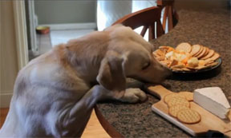
Mischief
Being naughty

Slide 3
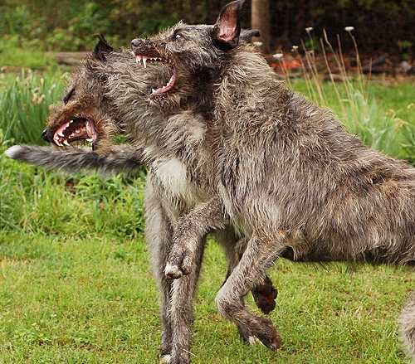
Gnashed
To rub your teeth together with noise to show anger, worry, or pain

Slide 4
Tamed
To make gentle

Slide 5
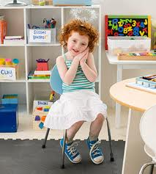
Which picture shows mischief?

Slide 6
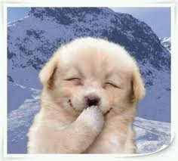
Which picture shows something gnashing it’s teeth?

Slide 7
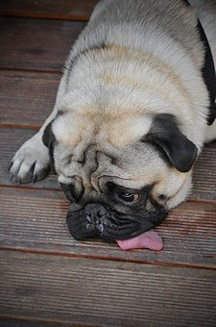
Which picture shows something tame?

Slide 8
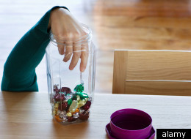
Which word goes with this picture?
(mischief, gnashed, tamed)

Slide 9
Which word goes with this picture? (mischief, gnashed, tamed)

Slide 10
Which word goes with this picture? (mischief, gnashed, tamed)

